Slide 1
Methods of DNA Methylation Analysis
CNRU

Slide 2
Review: Epigenetics
Study of mitotically heritable alterations in gene expression potential that are not mediated by changes in DNA sequence
Epigenetic regulation is critical for mammalian development and cellular differentiation
Epigenetic dysregulation causes human developmental diseases and cancer

Slide 3
Transcriptional competence is tied to regional chromatin structure
Chromatin structure depends in large part on:
  Histone modifications
  DNA binding proteins
  Methylation of cytosines within CpG dinucleotides*
    Modification is very stable (but is reversible)
    Correlated with locus specific transcriptional status
    From a clinical nutrition point of view, DNA methylation requires diet-derived methyl donors and cofactors; nutrition can affect this modification
    Goal: overview of methods to analyze DNA methylation

Slide 4
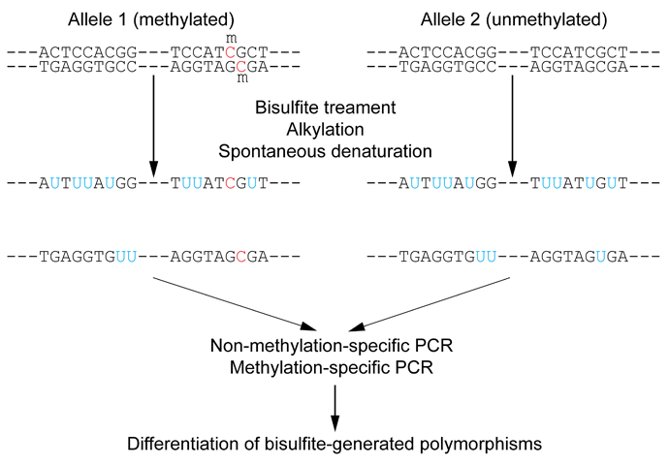
Major Advance: Conversion of unmethylated cystosines
to uracil using sodium bisulfite
Sequencing: unemethylated cytosines read as
thymidine in sense strand; adenine in the
anti-sense strand.
Other technologies evolved from here.

Slide 5
Decision Tree: Appropriate approach depends on the goal(s) of the study
For review see Shen & Waterland
Curr Opin Clin Nutr Metab Care
2007
Global or locus-specific?
Global
Gene specific
Genome-wide or candidate
gene?
1. Cytostine extension
2. Bisulfite sequencing of
repetitive elements
3. HPLC
Genome-wide
Candidate gene
Array-based or not?
Quantitative or sensitive?
Array based
Not
Quantitative
Sensitive
Allele specific or not?
Methyl light MSP
Allele specific
Not
Antibody of 5mC
binding
Methylation-sensitive
Restriction enzyme
3. Bisulfite modification
RGLS
Digital
Karyotyping
Library &
Sequencing
Bisulfite cloning
& Sequencing
Direct bisulfite
Sequencing:
Pyrosequencing
Manual sequencing
Mass array
MSP, methyl sensitive PCR

Slide 6
Global DNA Methylation Analysis:
Mammals, 70-80% of all CpG dinucleotides are methylated.
-most of this occurs in repetitive elements or
regions of low CpG density
CpG rich regions (CpG Islands):
-often found in gene promoters
- ‘generally’ unmethylated
HPLC:
-classic method to quantify DNA methylation
-highly quantitative and reproducible
-requires large amounts of DNA
-not suitable for high throughput analyses
PCR methods:
-developed to circumvent HPLC problems
-approximate global DNA methylation levels
by assessing repetitive elements (Alu and LINE)
-require little DNA; applied to parrafin
embedded tissues
Global or locus-specific?
Global
1. Cytostine extension
2. Bisulfite sequencing of
repetitive elements
3. HPLC
Disadvantage: no locus-specific information.

Slide 7
Global or locus-specific?
Gene specific
Genome-wide or candidate
gene?
Gene-Specific Methylation Analysis:
-Can be characterized as
1.‘candidate gene’ or
2.‘genome wide’ approaches

Slide 8
Genome-wide or candidate
gene?
Candidate gene
Quantitative or sensitive?
Quantitative
Sensitive
Allele specific or not?
Methyl light MSP
Allele specific
Not
Bisulfite cloning
& Sequencing
Direct bisulfite
Sequencing:
Pyrosequencing
Manual sequencing
Mass array
Candidate gene approach:
Can be divided into
Sensitive—methylated and unmethylated alleles are detected by
designing primers overlapping CpG dinucleotides.
Quantitative—primers are designed to amplify both methylated and
unmethylated alleles with equal efficiency, and methylation level is
analyzed using a variety of approaches

Slide 9
Sensitive Methods
After bisulfite modification, PCR is performed using two sets
of primers designed to amplify either methylated or unmethylated alleles.
Often referred to as MSP, or methylation sensitive PCR
Highly sensitive: can detect one methylated allele in a population of >
1000 unmethylated alleles.
Samples can be of limited quantity and quality.
MSP is not quantitative.
Variations of MSP:
  Methyl light & quantitative analysis of methylated alleles
    Use real time PCR for methylation detection
    Designed to detect fully methylated or fully unmethylated alleles
    Ignores the reality of partially methylated alleles
    Primer design is essential

Slide 10
Quantitative Methods
Except for one (Southern-based) method, all depend bisulfite
conversion.
Allele-specific bisulfite sequencing
-bisulfite modification of DNA; PCR amplification of region; ligated
into cloning vector; transfected into competent cells; antibiotic colonies grown,
picked, & expanded; plasmid DNA isolated and sequenced.
-each clone represents a single allele (yielding allele specific information)
-if enough clones are picked, it can be quantitative.
-technique is labor intensive and costly (NuPotential does this routinely).
Quantitative but not allele-specific
  -2a. employs direct radioactive sequencing of postbisulfite PCR products and
  quantification using a phosphoimager.
  -don’t sample a subset of alleles, rather averages across all alleles produced
  by PCR
  2b. Bisulfite PCR followed by restriction analysis (COBRA)
  -bisulfite modification; PCR amplification followed by digestions with a
  Restriction enzyme whose recognition sequence is affected by the bisulfite
  modification.; quantitated using gel electrophoresis/densitometry

Slide 11
Quantitative Methods (cont’)
3. Bisulfite pyrosequencing
  -relies on bisulfite conversion and PCR amplifcation and conversion of PCR
  product to single stranded DNA; pyroseuencing is essentially a primer
  extenstion method to analyze short- to medium- length DNA sequences.
  -drawback: only 25-30 bases can be sequenced in a reaction
4. Bisulfite PCR followed by MALDI-TOF MS
-DNA treated with bisulfite; regions of interest are PCR amplified; product
converted to single stranded DNA (T7 polymerase) then cleaved with
endonuclease;
-different cleavage patterns for the methylated and unmethylated CpG positions are
quantitated by mass spec.
KEY to quantitative methods: primer design and testing for PCR bias (methylated
and unmethylated DNA can be differentially amplified).

Slide 12
Genome-wide or candidate
gene?
Genome-wide
Array-based or not?
Array based
Not
Antibody of 5mC
binding
Methylation-sensitive
Restriction enzyme
3. Bisulfite modification
RGLS
Digital
Karyotyping
Library &
Sequencing
Technologies are improving to
increasingly enable assessment of
locus-specific DNA methylation
on genome wide scale.

Slide 13
Nonmicroarray-based genome-wide analysis
Restriction Landmark Genome Scanning (RLGS)
  -a 2D gel technique in combination with methylation-
  restriction enzymes (NotI and AscI)
  -yields methylation profiles of thousands of loci at once
  -Drawbacks: limited genome coverage (up to 10% of CpG islands) and sensitivity (requires 30% methylation to be detectable).
Methylation specific karyotyping (MSDK)
  -fairly recently developed
  -conceptually similar to SAGE (serial analysis of gene expression)
  -relies on cleavage of genomic DNA w/methylation sensitive enzyme (AscI)
  -Short sequence tags are sequenced and mapped
Limited digestion with McrBC*
  -construct methylated and unmethylated domains using limiting restriction digestion with McrBC; fragments transfected into E. coli and plasmid DNA sequenced
  -Consensus is growing that these types of approaches (which
  depend on massive parallel sequencing techniques) will surpass array-based approaches.

Slide 14
Microarray-based genome-wide analysis: 4 classes have been developed to map ^{5m}C patterns
Methylated DNA immunoprecipitation (MeDIP)
  -requires immunoprecipitation of DNA using antimethylcytosine antibody followed by hybridization to DNA microarrays.
  -requires large amounts of genomic DNA and antibody
  -two modifications to improve sensitivity:
  a . Ligation-mediated PCR (LM-PCR)-requires blunt end ligation (poor efficiency) and appears to bias towards GC-poor regions*
  b. methylated CpG island recovery assay (MIRA)*
  -applied to genome-wide methylation analysis in cancers
  -requires a column purifications step; columns not commercially available.
  *a & b lack sensitivity

Slide 15
Microarray-based genome-wide analysis (cont.)
2. Oligo arrays
-incorporates bisulfite PCR and specially designed oligo arrays; quantifies bisulfite induced C to T change at defined genomic positions;
-requires gene specific PCR, but method can interrogate multiple CpG sites within hundreds of genes at once;
-approach does no represent the entire genome; primer design can be challenging.
4. Differential hybridization
  -genomic DNA digested with MseI (methylation independent), ligated with linkers, then digested with BstUI or HpaII (methylation sensitive) to remove unmethylated fragments); digested DNA is amplified, products labeled and hybridized to array.

Slide 16
Microarray-based genome-wide analysis (cont.)
4. Methylated CpG island amplification combined with microarray (MCA)
-uses methylation sensitive and insensitive isoschizomers
-DNA incubated w/ methylation sensitive restrcition enzyme (SmaI) that digests unmethylated DNA, leaving methylated DNA in tact;
-the same DNA is then digested with a methylation insensitive SmaI isoschizomer (XmaI).
SmaI leaves blunt ends
Xma leaves sticky ends; Xma adapters allow adapter specific PCR; product labeled and hybridized to array.
  -OK for cancer; we had no luck with diets, etc.

Slide 17
Conclusion
High throughput methods for genome-wide methylation analysis are being developed
Should become commercially available in the next few years
But, methylation changes detected by the developing methods will still need to be validated using locus specific methods
Nutrition offers a key challenge: induces subtle changes in DNA methylation (unlike cancer model)

